Slide 1
Requirement Analysis

Slide 2
Definition
Requirement analysis is significant and essential activity after elicitation.
We analyze, refine, and scrutinize the gathered requirements to make consistent and unambiguous requirements.
This activity reviews all requirements and may provide a graphical view of the entire system. After the completion of the analysis, it is expected that the understandability of the project may improve significantly.
Here, we may also use the interaction with the customer to clarify points of confusion and to understand which requirements are more important than others.

Slide 3
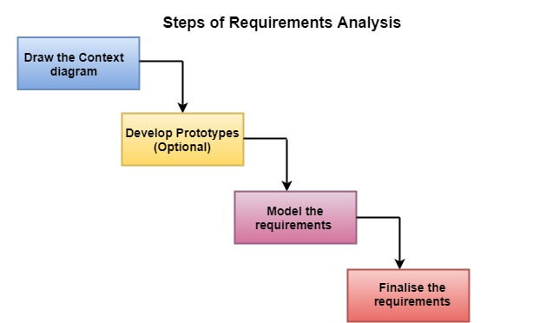

Slide 4
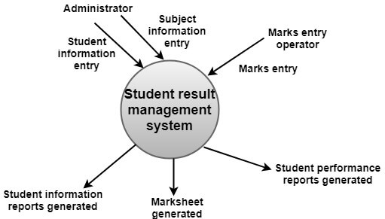
(i) Draw the context diagram: The context diagram is a simple model that defines the boundaries and interfaces of the proposed systems with the external world. It identifies the entities outside the proposed system that interact with the system.

Slide 5
(ii) Development of a Prototype (optional): One effective way to find out what the customer wants is to construct a prototype, something that looks and preferably acts as part of the system they say they want.
We can use their feedback to modify the prototype until the customer is satisfied continuously. Hence, the prototype helps the client to visualize the proposed system and increase the understanding of the requirements. When developers and users are not sure about some of the elements, a prototype may help both the parties to take a final decision.

Slide 6
(iii) Model the requirements: This process usually consists of various graphical representations of the functions, data entities, external entities, and the relationships between them. The graphical view may help to find incorrect, inconsistent, missing, and superfluous requirements. Such models include the Data Flow diagram, Entity-Relationship diagram, Data Dictionaries, State-transition diagrams, etc.

Slide 7
(iv) Finalise the requirements: After modeling the requirements, we will have a better understanding of the system behavior. The inconsistencies and ambiguities have been identified and corrected. The flow of data amongst various modules has been analyzed. Elicitation and analyze activities have provided better insight into the system. Now we finalize the analyzed requirements, and the next step is to document these requirements in a prescribed format.

Slide 8
Activities for Requirement Analysis
Eliciting requirements: the task of communicating with customers and users to determine what their requirements are. This is sometimes also called requirements gathering.
Analyzing requirements: determining whether the stated requirements are unclear, incomplete, ambiguous, or contradictory, and then resolving these issues.

Slide 9
Requirements modeling: Requirements might be documented in various forms, such as natural-language documents, use cases, user stories, or process specifications.
Review and retrospective: Team members reflect on what happened in the iteration and identifies actions for improvement going forward.

Slide 10
Requirements analysis is a team effort that demands a combination of hardware, software and human factors engineering expertise as well as skills in dealing with people.
Here are the main activities involve in requirement analysis:
Identify customer's needs.
Evaluate system for feasibility.
Perform economic and technical analysis.
Allocate functions to system elements.
Establish schedule and constraints.
Create system definitions.

Slide 11
Stakeholder
The term Software Project Stakeholder refers to, “a person, group or company that is directly or indirectly involved in the project and who may affect or get affected by the outcome of the project”.
It is the process of identifying a person, group or a company which can affect or get affected by a decision, activity or the outcome of the software project. It is important in order to identify the exact requirements of the project and what various stakeholders are expecting from the project outcome.

Slide 12
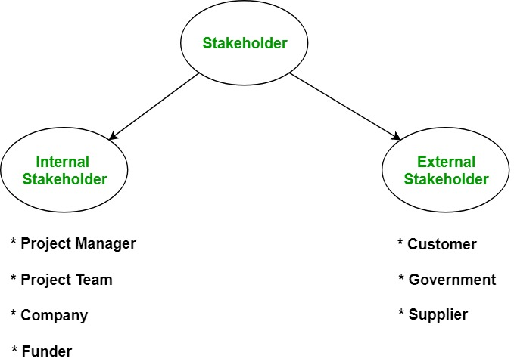

Slide 13
Type of Stakeholders
Internal Stakeholder:
Project Manager: Responsible for managing the whole project. Project Manager is generally never involved in producing the end product but he/she controls, monitors and manages the activities involved in the production.
Project Team: Performs the actual work of the project under the Project Manager inluding development, testing, etc.

Slide 14
Company: Organisation who has taken up the project and whose employees are directly involved in the development of the project.
Funders: Provides funds and resources for the successful completion of the project.

Slide 15
External Stakeholder:
An external stakeholder is the one who is linked indirectly to the project but has significant contribution in the successful completion of the project.
Customer: Specifies the requirements of the project and helps in the elicitation process of the requirement gathering phase. Customer is the one for whom the project is being developed.
Supplier: Supplies essential services and equipment for the project.

Slide 16
Government: Makes policies which helps in better working of the organisation.

